Slide 1



City County Transportation Update
January 29, 2026
Presented by: AJ Arjanen
General Manager
Notes:
Honorable Mayor, Council, and City leadership
Excited to be here and re-introduce the city to City/County Transportation
Over the next several minutes, I will discuss
Who we are, What we do, and Why we do it
Where we were
Where we are
And Where we are going

Slide 2

Introduction to City/County Transportation
Provide Demand Response (door-to-door pick up and drop off) services throughout Johnson County, to include Texas Health Huguley Hospital
Citizens rely upon our services as a form of mobility for trips to vital medical appointments, employment, grocery shopping, senior centers, leisure, etc.
  68% of trips are attributed to elderly & disabled
  27% of trips require a wheelchair, scooter, cane, etc.
Team consists of 16 drivers, two dispatchers, and a transportation coordinator
Transportation services are provided to the community M-F (6am-6:30pm) with limited Saturday service
Funding Sources: FTA (TxDOT & North Central Council of Governments [NCTCOG]) and participating Cities
Notes:
Provide curb-to-curb pick up and drop off services throughout Johnson County, to include Texas Health Huguley Hospital M-F 6am-6:30pm, with limited Sat service.
Citizens rely upon our services as a form of mobility for trips to vital medical appointments, employment, grocery shopping, senior centers, leisure, etc.
68% of trips are attributed to elderly & disabled
27% of trips require a wheelchair, scooter, cane, etc.
Funding Sources: FTA (TxDOT & North Central Council of Governments [NCTCOG]) and participating Cities

Slide 3
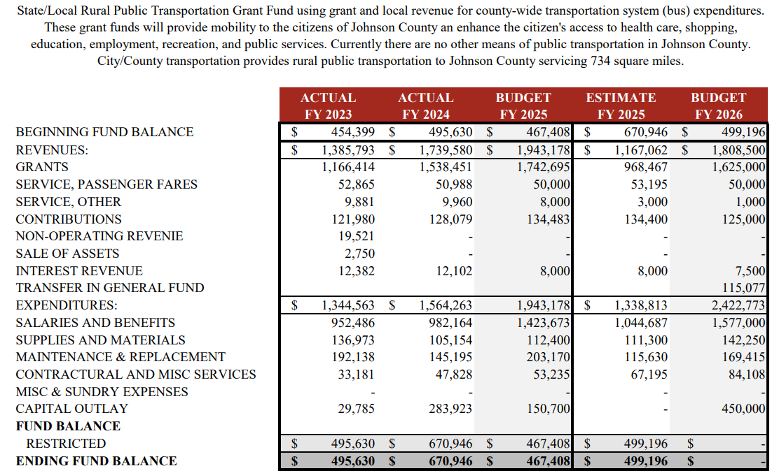
Introduction to City/County Transportation Cont.
Notes:
We are committed to remain fiscally responsible with the citizens tax dollars and always strive to improve efficiency.
The operating budget is $1.97M.
80% Labor/Fringe
9% M&R (Maint and Repairs)
7% Supplies/Materials
4% Contractual/Miscellaneous

Slide 4
City/County Transportation Participating Entities
Participating Cities:
  Alvarado
  Burleson
  Cleburne
  Godley
  Grandview
  Joshua
  Keene
  Rio Vista
  Johnson County
Notes:
This is a list of our participating cities/county.

Slide 5

“Drivers with a servant’s heart, quietly uplift lives. Your care for others, reliability and pride in service builds trust, restores dignity, propels our community forward, and most importantly, has the power to transform lives.”
Notes:
This is quote is how I share with our drivers
Used to influence
Culture change
Promote buy in and support of our Vision and Mission Statements
Enrich the workforce
Ensure they understand their importance

Slide 6
Purpose Statements
Vision Statement:
  To deliver the safest, most reliable, customer-centered mobility service
Mission Statement:
  To serve the people of Johnson County with safe, dependable, customer-driven transportation services that advances community access and elevates our customer’s quality of life
Notes:
We have so much potential to create something amazing, which is why our purpose statements are so vital.
The brilliance of a broad Vision Statement is we never know if we have arrived.
Requires constant improvement to inch closer.
And of course our Mission is the road map of how we get there.

Slide 7
FY2025 In Review
We concluded the fiscal year on a strong note, achieving significant efficiency gains. Key year-over-year highlights include:
  8.4% increase in Passenger Trips
    Cleburne accounted for:
      59.8% Orig / 60.4% Dest of all trips in FY25
      10.3% of cross-city trips into Cleburne
  9.5% improvement in Trips per Revenue Hour (a key productivity metric)
  15.2% increase in Passenger Miles Traveled
  26.7% increase in passenger fares
The team’s proactive engagement with ridership and performance metrics exemplifies strong commitment to excellence
Notes:
8.4% ridership (1,700 trips) increase year over year.
Cleburne= 11,727 orig (59.8%) / 11,845 dest (60.4%) / 23,572 all (60.1%) *2,022 (9%) trips orig outside Cleburne
Burleson=4,743 orig (24.2%) / 5,014 dest (25.6%) / 9,757 all (24.9%) *1,079 (11%) trips originated outside Burleson
County 3,125 orig (16%) / 2,766 dest (14%) / 5,891 all (15%)
Most proud of our culture change…Buy in …. improved attendance…. Drivers inquiring about growth metrics

Slide 8
What We Are Doing
Improved Service Offering
  Analytics revealed a gap in service needs.
    Expanded service with new 6:00 AM start time throughout Johnson County
    Partnered with dialysis facilities to offer service on holiday’s to better meet customer’s medical needs
October 2025, highest ridership in excess of five years
Improved communication with all key stakeholders
Deep dive into operational needs vs. current operations
  Reallocating resources accordingly
Reimagining what City/County Transportation can be
Notes:
Improving access to early medical appointments, employment, and essential trips across Johnson County
October 2025 – 13% or added 268 trips (2,337); December 2025 2nd highest in over five years (45% increase/710 more rides)
Scheduling presentations with partner cities/ Commissioner’s Court
Re-imaging what we can be… an emulation of what customer service should be; better service, quicker response, improved flexibility

Slide 9
Where We Are Going
Service Enhancements
  Coordination with medical providers, employers, businesses, etc.
Vehicle Replacement Acquisition
  TXDOT funded grant for 3 new buses
Transit Software Solicitation
  NCTCOG funded grant fully approved
Relaunch/Rebrand
  Drive improved awareness
Growth mindset in 2026
  Grow ridership by 30% through 2026
  Evaluation of fixed route service
Notes:
***What we identified in review from the previous slide and steps to address.
Service Enhancements- How can we better serve our customers and all of our community; drive economic activity, accessibility for employers and businesses
Buses- Asset management to ensure our vehicles are in safe and strong mechanical order
Software- Present software is antiquated (2009), overly manual, unreliable, down time, complaints about hold times to schedule rides, terrible turn by turn directions for drivers
Software 2) Ecolane; greatest value; State of the art; Smart, optimization, powerful analytics, more importantly, customer friendly:
Highlights include Mobile App, Web Portal (Bi-Lingual); schedule/cancel trips, pay fare, notifications (trip reminders, where’s my ride)
-Relaunch/rebrand very much needed. Few know about us or the services we provide; an unpleasant reputation of unreliability and unavailability

Slide 10
City County Transportation Update
For further information, contact:
AJ Arjanen, General Manager
AJ.Arjanen@cleburne.net
(817) 357-4463
Notes:
Thank you for your time this morning. I would welcome any questions you may have.

